Slide 1
General Problem Solvers for Combinatorial Optimization Problems by Metaheuristics
Toshihide Ibaraki
(with M. Yagiura and K. Nonobe)
Kyoto University
SIAM Conference on Optimization, Toronto, May 22, 2002

Slide 2
Outline of the talk
Combinatorial optimization problems
Standard problems and general problem solvers
Metaheuristics
Implementations and computational results for some applications
Future directions

Slide 3


Combinatorial optimization problems
minimize (maximize) f (x)
subject to x∈F
where feasible region F is combinatorial (discrete); e.g.,
a subset of , a subset of , edge set E of a graph
G= (V, E ), vertex set of G, the set of all permutations
of n elements, a family of subsets of an n-set, the set
of mappings from an n-set to an m-set, etc.
These are abundant in real world applications.

Slide 4
General problem solvers?
 Many combinatorial problems are difficult to solve
(e.g., NP-hard) and need time to develop effective algorithms.
⇒ General problem solvers are necessary.
 In this direction, theory tells that all problems in NP can be reduced to an NP-hard problem A.
⇒ An algorithm for A can be used as a general problem
solver.
 The NP-hard problem A is difficult to solve exactly.
⇒ Approximate algorithm for A.

Slide 5
The reductions between NP problems may blow up
the sizes.
The reductions may not preserve the metric of
objective functions. (A good solution of A may
not be a good solution of the target problem. )
⇒ Natural reductions are desirable.

Slide 6
 Different types of standard problems A₁, A₂, …, A_{k}
must be prepared.
⇒ The problem instance at hand is formulated as
an instance of an appropriate standard problem A_{i},
and is then solved by an algorithm for A_{i}..

Slide 7
Our list of standard problems
 Integer programming problem (IP); Commercially available.
 (Weighted) constraint satisfaction problem (CSP, WCSP)
 Maximum satisfiability problem (MAX SAT)
 Set covering problem (SCP)
Generalized assignment problem (GAP)
 Generalized quadratic assignment problem (GQAP)
 Resource constrained project scheduling problem (RCPSP)
 Vehicle routing problem (VRP)
 Cutting stock problem (CSTP)
 2-Dimensional Packing Problem (2PP)
 …

Slide 8
● Each standard problem A_{i} must be as general
as possible, while maintaining its special
structure that allows a specialized solution
strategy.

Slide 9
● Algorithms for standard problems must be
-- efficient in the practical sense,
-- robust against small structural changes in the
problems,
-- easy to apply.
Metaheuristics
-- simulated annealing,
-- genetic algorithms,
-- iterated local search,
-- tabu search,
-- others

Slide 10

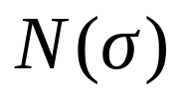
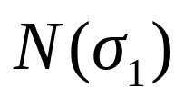
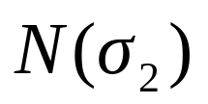
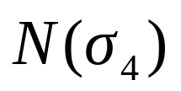
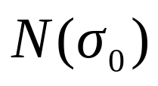

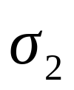
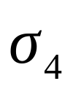
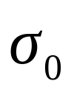
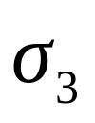
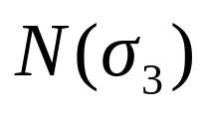
Local search（LS） repeats replacing
with a better solution in its neighborhood
an initial solution
locally optimal

Slide 11
General framework of metaheuristics
Repeat the following steps until a convergence criterion
is satisfied.
Step 1: Generate an initial solution (based on the compu-
tational history so far).
Step 2: Apply (generalized) local search to find a good
locally optimal solution.
Step 1 -- random generation, mutation, cross-over operation,
path relinking, …, from population of good solutions obtained so far.
Step 2 -- simple local search, random moves with controlled probability,
best moves with a tabu list, local search with modified objective
functions (e.g., with penalty of infeasibility), ...

Slide 12
Our list of standard problems
 Integer programming problem (IP); Commercially available.
 (Weighted) constraint satisfaction problem (CSP, WCSP)
 Maximum satisfiability problem (MAX SAT)
 Set covering problem (SCP)
Generalized assignment problem (GAP)
 Generalized quadratic assignment problem (GQAP)
 Resource constrained project scheduling problem (RCPSP)
 Vehicle routing problem (VRP)
 Cutting stock problem (CSTP)
 2-Dimensional Packing Problem (2PP)
 …

Slide 13
Resource constrained project scheduling
problem (RCPSP)
 Activities j = 1,2, …, n.
 Resources r =1, 2, …, R and s =1, 2, …, S.
-- renewable resources (machine, manpower, etc.): K_{r, t}
available in each period t,
-- nonrenewable resources (budget, raw materials, etc.):
K_{s} available in total.
 Process mode m of each activity can be chosen.
-- processing time p_{m},
-- renewable resources k_{r,m,t} in the t-th period after start,
-- nonrenewable resources k_{s,m} .

Slide 14
RCPSP
Activities
a₁
a₃
a₅
Consumed
amount
a₂
a₄
Available
amount
Resource 1
Available
amount
Resource 2
Time

Slide 15
Constraints and objectives to be included
 Precedence constraints between activities.
 Objective functions to minimize
-- makespan, weighted sum of delays, …
 Setup activities.
Other constraints on modes, start times, completion times and/or processing times.
 Schedules to minimize the weighted sum of penalties on constraints,
-- hard and soft constraints.

Slide 16
Implementation of RCPSP
 Tabu search.
 Solutions are encoded as (m, π), where m is the
modes of activities and π is a permutation of all
activities.
 Heuristic algorithm to construct a schedule from
(m, π), which satisfies all hard constraints.
 Reduced neighborhood obtained from the critical
path analysis of the current schedule.
 Automatic control of the tabu tenure.

Slide 17
Computational experiment
 Job shop scheduling
 Benchmark problems in PSPLIB
 Problems from real applications.
 ・・・

Slide 18
Ship scheduling
 Transportation of natural resources;
e.g., oil, iron ore, etc.
 Activities: trips of given origins, destinations, and
amounts of resources.
 Two types of ships: proprietary and chartered.
 Constraint on the storage level at the yard (tank).
 Objective: Minimization of the number of chartered
trips.

Slide 19

Ship Scheduling

Slide 20
Schedule table
1
/
1
2
3
4
5
6
7
8
9
10
11
12
13
14
15
16
17
18
19
20
21
22
23
24
25
26
27
28
29
30
Proprietary
ship 1
Proprietary
ship 2
…
Proprietary
ship n
Chartered
ships
round trip
unloading

Slide 21
Constraint on the levels of tanks (yards)
Given: Consumption rate from each tank (yard).
Capacities of tanks (yards): upper and lower bounds.
level
unloading finished
upper
bound
lower
bound
small ship
time
large ship
unloading started

Slide 22
Typical instances
 # activities: about 100.
 Scheduling horizon: 1 year
 # proprietary ships: 4
 # chartered ships: 5
 # destinations: 4
Computation time
 Succeeded to obtain practically useful schedules
in about 10 minutes on SUN SPARC ULTRA 2.

Slide 23
Work space scheduling of large construction parts
--- 2-dimensional packing of activities ---
Large construction parts (ships,
bridges, etc.) in a narrow factory.
Each part occupies some area, and
stays in the same place until
completion. (Then it is removed
by a crane.)
Each part has its ready time, deadline,
and processing time. Required
resources change with time.
◆
◆
Length L
◆

Slide 24
Solution strategy
1st stage: After discounting L to σL (e.g., σ = 0.9),
apply RCPSP in the direction of t under the resource
amount of σL..
2nd stage: Apply RCPSP in the direction of L,
assuming that each day has unit amount of its own
resource (each activity consumes the resources of
the scheduled days).
◆
１ｓｔ
◆
2nd

Slide 25
Our list of standard problems
 Integer programming problem (IP); Commercially available.
 (Weighted) constraint satisfaction problem (CSP, WCSP)
 Maximum satisfiability problem (MAX SAT)
 Set covering problem (SCP)
Generalized assignment problem (GAP)
 Generalized quadratic assignment problem (GQAP)
 Resource constrained project scheduling problem (RCPSP)
 Vehicle routing problem (VRP)
 Cutting stock problem (CSTP)
 2-Dimensional Packing Problem (2PP)
 …

Slide 26
2-Dimensional packing problem
Input: A set of rectangles I = {1,2,…,n};
each i has several modes.
mode: (width, height, spatial cost functions)
Output: Modes and x, y coordinates of all rectangles.
It is asked to place all rectangles in the plane
without overlap so that the objective function
is minimized.

Slide 27
Mathematical formulation
Input: Modes (w_{i}^{(k)}, h_{i}^{(k)}, p_{i}^{(k)}(x_{i}), q_{i}^{(k)}(y_{i})) for
i∈{1,2,…,n} and k∈M_{i} ,
objective functions : g and c.
Output : A solution π, i.e.,
packing (x_{i}(π), y_{i}(π)) (lower left corner),
mode μ_{i}(π), for all i∈{1,2,…,n}.
p_{max}(π) = max _{i} p_{i}^{(μ}i ^{(π))}(x_{i}(π)) (ｓimilarly, q_{max}(π) )
minimize g( p_{max}(π), q_{max}(π)) + c(μ(π))
subject to : no overlapping

Slide 28
Functions p_{i}^{(k)}(x_{i}) and q_{i}^{(k)}(y_{i}) can be very general:
These can be nonconvex, noncontinuous as
long as piecewise linear.
Objective function g( p_{max}(π), q_{max}(π)) is
nondecreasing in p_{max}(π) and q_{max}(π) .

Slide 29
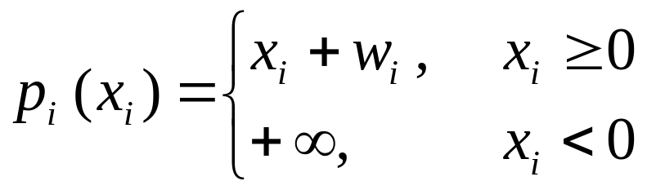
Example１
-- smallest area packing --
y
0
x

Slide 30
Example 2 -- scheduling problem --
Building block i ∈{ 1, 2, …, n }:
length h_{i} , processing time w_{i} , ready time s_{i} , due date d_{i}
bring in
carry out
 block i
              h_{i}
Work space L
Determine the place and the start time of each block.

Slide 31

Rectangle: (processing time) × (length)
cost function
time
p_{i}(x_{i})
ready time
s_{i}
start time
x_{i}
due date
d_{i}
L
work space
0
s_{i}
d_{i} − w_{i}
x
q_{i}(y_{i})
place
y_{i}
block i
h_{i}
0
L - h_{i}
y
0
w_{i}
objective function
g(p, q) = p + q

Slide 32
Representation of solutions
Direct search of rectangle locations is not appropriate, because there are uncountably many solutions.
Sequence pair (Murata, Nakatake, Fujiyoshi and
Kajitani（1995）): Relative nonoverlapping positions
are specified by a sequence pair of rectangles.

Slide 33
Search strategy of solutions
Local search is applied to search good sequence pairs and modes of rectangles.
  Shift, swap and change mode neighborhoodｓ reduced by critical path ideas.
2. Given a sequence pair, exact optimal locations
are computed by dynamic programming algorithm
in polynomial time.

Slide 34
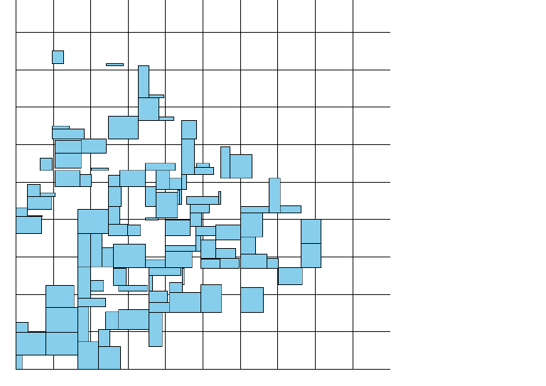
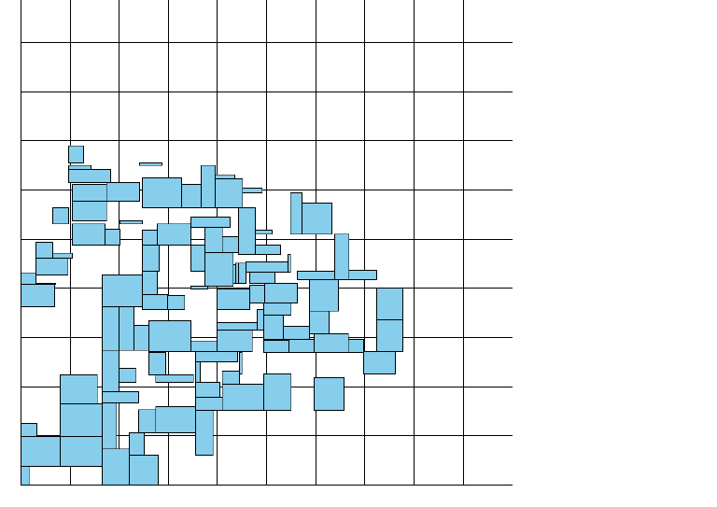
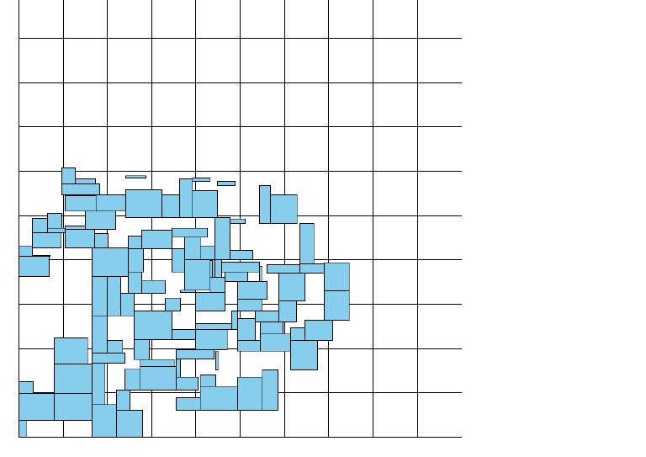
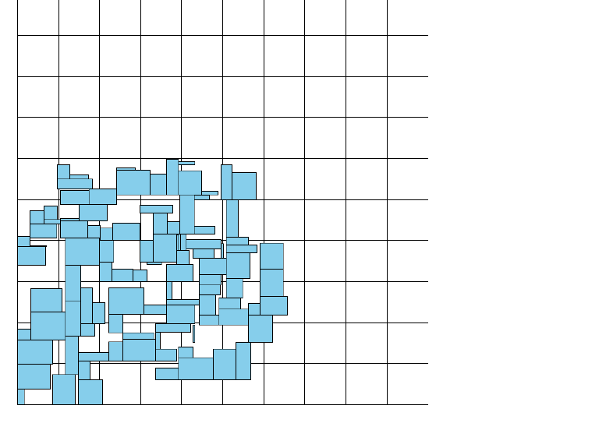
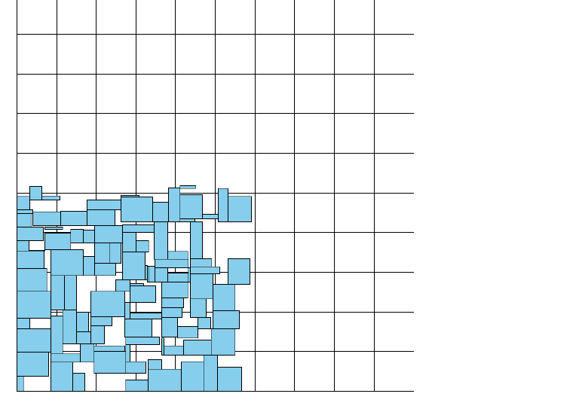
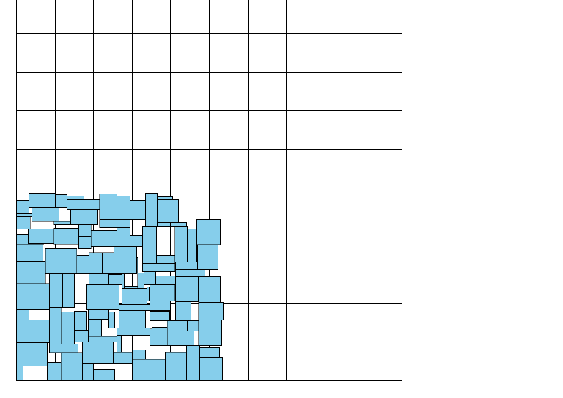
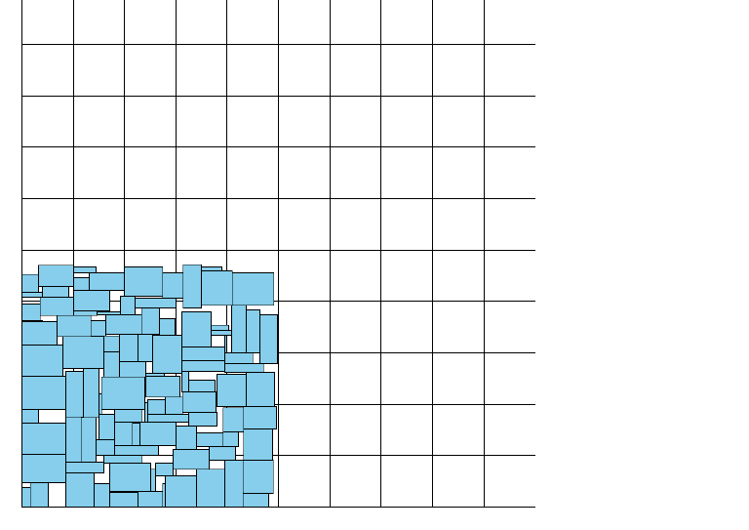
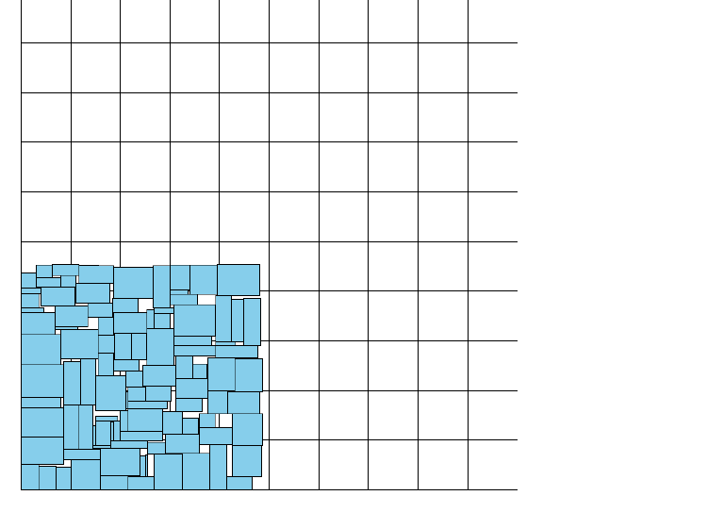
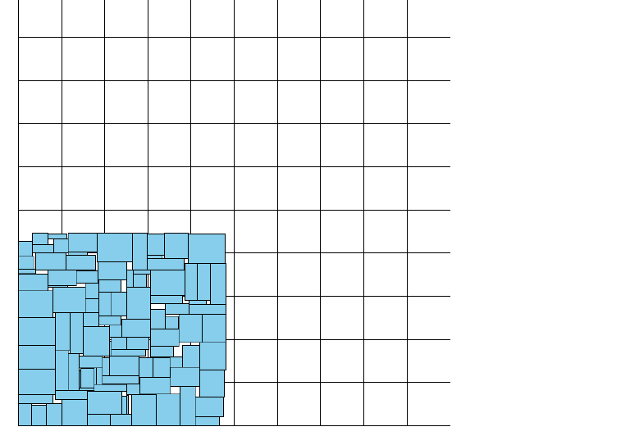

Packing rectangles into a small area

Slide 35

Conclusion and discussion
Further improvement of metaheuristic algorithms.
Increasing the formulation power of standard problems.
Other standard problems.
User interfaces. Supports for modeling the problems in applications.

